Slide 1
PROJECT REPORT
Web Application Penetration Testing Using DVWA
Submitted By: Syed Suffiyan
BCA, Yenepoya Institute Of Arts, Science, and Management
Internship: Cybersecurity Internship at Apex Planet
Date: 21 April 2026

Slide 2
Table of Contents :
1. Abstract
2. Introduction
3. Tools and Environment
4. Methodology
4.1 Reconnaissance &Network Scanning
4.2 SQL Injection (SQLi)
4.3 Brute Force Attack
4.4 Cross-Site Scripting (XSS)
5. Results and Findings
6. Screenshots / Evidence
7. Mitigation Techniques
8. Incident Response
9. Conclusion
10. References

Slide 3
Abstract
This project, titled “Web Application Penetration Testing using DVWA,” focuses on gaining practical experience in identifying and exploiting common web application vulnerabilities within a controlled environment. A deliberately vulnerable platform, DVWA, was utilized to simulate real-world cyberattack scenarios, with all testing conducted in a secure Kali Linux environment.
The assessment included key attack vectors such as reconnaissance, SQL Injection (SQLi), Brute Force attacks, and Cross-Site Scripting (XSS), enabling a comprehensive understanding of potential security risks. Additionally, the project examined the application from an incident response perspective, highlighting detection techniques and recommending mitigation strategies, including parameterized queries and effective input validation.
Overall, this project bridges the gap between offensive penetration testing and defensive security practices, providing a well-rounded understanding of web application security.

Slide 4
Introduction
With the rapid expansion of digital infrastructure, web applications have become the primary gateway to sensitive corporate and user data, making them prime targets for cyber threat actors. Understanding how these applications are compromised is a fundamental requirement for building secure and resilient systems.
The primary objective of this project is to simulate real-world cyberattacks in a safe, legal, and controlled laboratory environment. This approach enables the analysis of common vulnerabilities consistently identified in the OWASP Top 10 (Open Web Application Security Project).
By actively exploiting these vulnerabilities, the project provides valuable insight into attacker methodologies, enhancing the ability to detect, prevent, and respond to potential security threats in real-world production environments.

Slide 5
3. Tools and Environment
To maintain a secure, isolated, and legally compliant testing environment, this project was conducted using virtualized systems configured on a host-only network.
The following tools and platforms were utilized:
1.Attacker Machine: Kali Linux – A Debian-based distribution designed for digital forensics and penetration testing, featuring a comprehensive suite of security tools.
2.Target Application: DVWA (Damn Vulnerable Web Application) – A PHP/MySQL-based web application intentionally designed with vulnerabilities for ethical security testing.
3.Network Scanning Tool: Nmap – Used for network discovery and vulnerability assessment. 4.Password Cracking Tool: THC Hydra – A high-speed tool for performing automated brute-force attacks on login credentials. Web Testing Tools: Mozilla Firefox (configured with FoxyProxy) and Burp Suite Community Edition – Used for intercepting, analyzing, and modifying web traffic.

Slide 6
4. Methodology
The testing followed a structured penetration testing approach, starting from reconnaissance to exploitation.
4.1 Reconnaissance & Network Scanning
Purpose: Identify active services and entry points. The command nmap -sC -sV <target_IP> was utilized to run default scripts and determine service/version information.
Tool Used: Nmap Key Finding: Open ports 80 (HTTP) and 3306 (MySQL) confirmed the presence of a web application and database
4.2 SQL Injection (SQLi)
Purpose: Test input validation weaknesses
Method: Injected SQL payloads (e.g., ' OR '1'='1) Result: Authentication bypass achieved, granting unauthorized access
4.3 Brute Force Attack
Purpose: Test password security Tool
Used: THC Hydra Method: Dictionary-based attack using common credentials Result: Valid login credentials successfully obtained due to lack of rate limiting

Slide 7
4.4 Cross-Site Scripting (XSS)
Purpose: Test client-side security
Method: Injected script payload () Result: Reflected XSS executed in browser Stored XSS saved in database and triggered on page visit​

Slide 8
5. Results and Findings
The penetration testing phase identified several critical and high-risk vulnerabilities within the DVWA environment. The findings are summarized below, ordered by severity.
5.1 Authentication Bypass
Severity: Critical
Description: A SQL injection (SQLi) vulnerability was identified in the login portal.
Impact: This flaw allows an attacker to bypass authentication mechanisms entirely. By injecting malicious SQL queries, an unauthorized user can gain full access to the application without providing valid credentials.
Recommendation: Implement prepared statements (parameterized queries) and utilize input validation to prevent SQL injection.
5.2 Weak Password Policies & Lack of Rate Limiting
Severity: High
Description: The application lacks account lockout or rate-limiting mechanisms. A brute-force attack using Hydra successfully compromised user accounts.

Slide 9
Impact: The system is highly susceptible to automated credential stuffing and brute-force attacks. This allows attackers to gain unauthorized access by systematically guessing passwords.
Recommendation: Enforce strong password complexity requirements and implement rate limiting or CAPTCHA after a set number of failed login attempts.
5.3 Client-Side Code Execution (Stored XSS)
Severity: High
Description: The application is vulnerable to Stored Cross-Site Scripting (XSS). Malicious scripts can be injected and stored on the server.
Impact: This poses a high risk of session hijacking. An attacker can steal administrator session cookies or perform actions on behalf of the user simply by having the victim view a compromised page.
Recommendation: Sanitize all user-supplied input and implement a strong Content Security Policy (CSP) to restrict the execution of unauthorized scripts.

Slide 10
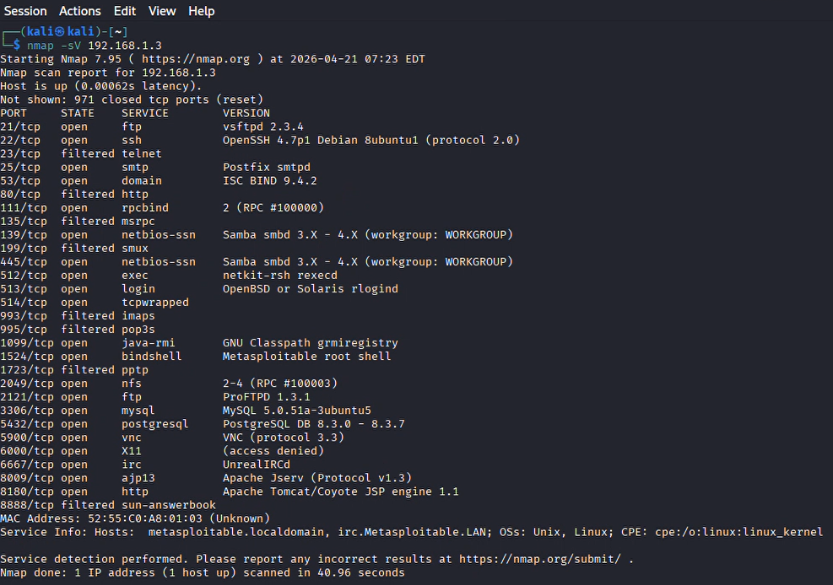
6. Screenshot / Evidence
Figure 1: Nmap Scan Result

Slide 11
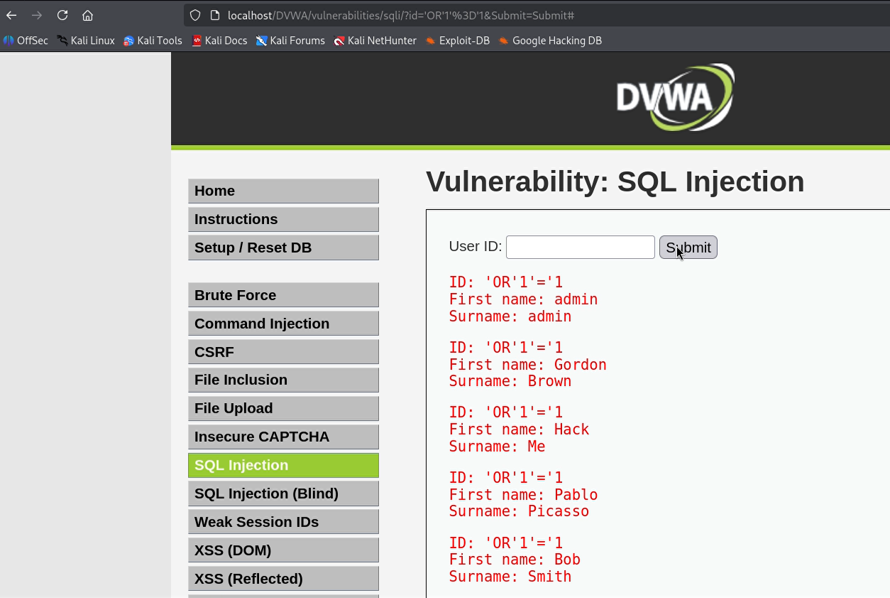
Figure 2: SQL Injection Authenticatiom Bypass

Slide 12
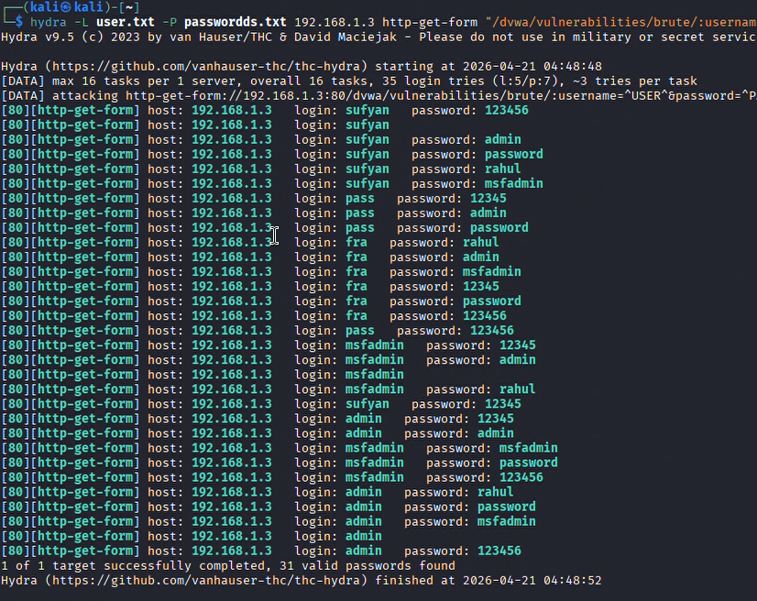
Figure 3: Hydra Brute Force Success

Slide 13
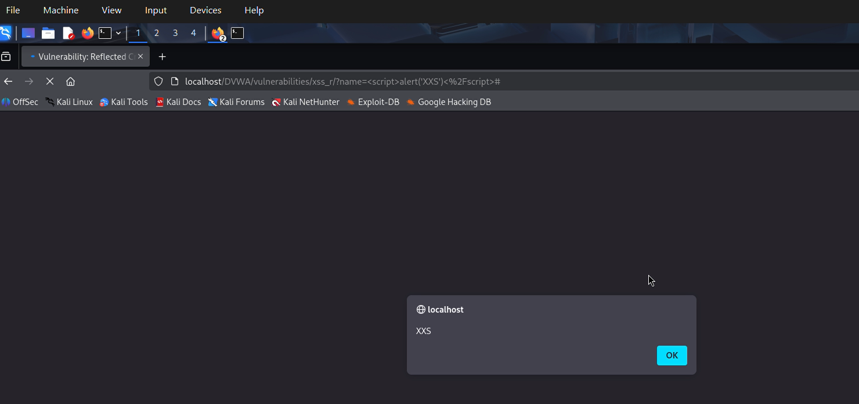
Figure 4: Stored XSS Execution

Slide 14
7. Mitigation Strategies Objective
To secure the application, the following defensive measures must be integrated into the source code:
1. SQL Injection (SQLi) Defense:
Primary Action: Implement Prepared Statements (Parameterized Queries).
How it works: Treats user input as string data only, preventing the database from executing it as a command.
2. Brute Force Protection:
Access Control: Enforce Account Lockout Policies (e.g., 5 failed attempts = 15-minute lockout).
Validation: Integrate CAPTCHA to block automated tools like Hydra.
Hygiene: Require strong password complexity rules.
3. Cross-Site Scripting (XSS) Mitigation:
Sanitization: Strict Input Validation using "allow-lists" for characters.
Encoding: Use Context-Aware Output Encoding (convert characters like < and > to HTML entities).
Policy: Deploy a strict Content Security Policy (CSP).

Slide 15
8. Incident Response
Objective: Essential detection strategies for Blue Teams and Security Operations Centers (SOC) to identify live attacks.
I. Reconnaissance Detection
Indicator: Unusually high connection volumes across multiple ports from a single IP.
Tools: Use IDS (Intrusion Detection Systems) like Snort or Zeek to flag port scans.
II. SQLi & XSS Detection
WAF Monitoring: Configure Web Application Firewalls to inspect HTTP traffic for malicious signatures (e.g., UNION SELECT, 'OR 1=1', or *<script>).
Log Analysis: Audit Apache/Nginx access logs for these characters in URL parameters for post-incident forensics.
III. Brute Force Detection
SIEM Configuration: Set high-threshold alerts for HTTP 401 (Unauthorized) or HTTP 302 (Redirect) responses.
Pattern: Watch for multiple failed login attempts against a single account within a short timeframe.

Slide 16
9. Conclusion
Project Overview: Web Application Penetration Testing using DVWA.
Key Takeaways
Practical Exploitation: Successfully utilized industry-standard tools to manually exploit SQLi, XSS, and Weak Authentication.
System Impact: Demonstrated how these vulnerabilities directly compromise the CIA Triad (Confidentiality, Integrity, and Availability).
Defensive Necessity: Highlighted the critical link between proactive Incident Response and Secure Coding practices.
Final Summary
This internship project successfully solidified a practical foundation in:
1. Offensive Security (Penetration Testing)
2. Defensive Architecture (Network Monitoring)

Slide 17
10. References
OWASP Top 10 Web Application Security Risks:
DVWA (Damn Vulnerable Web App) Documentation:
Kali Linux Official Documentation:
Nmap Network Scanning Guide:
TCH hydra Respsitory

Slide 18
THANK YOU

